Slide 1
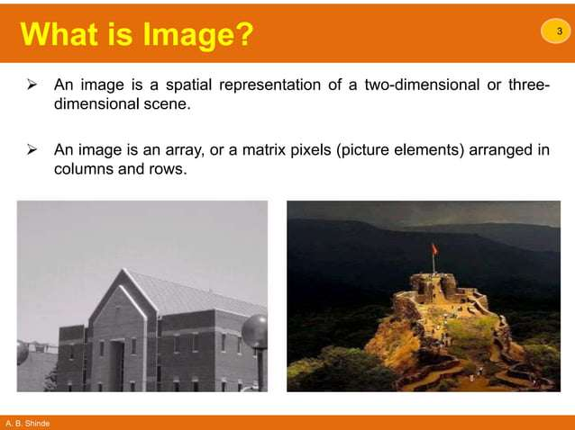

Slide 2
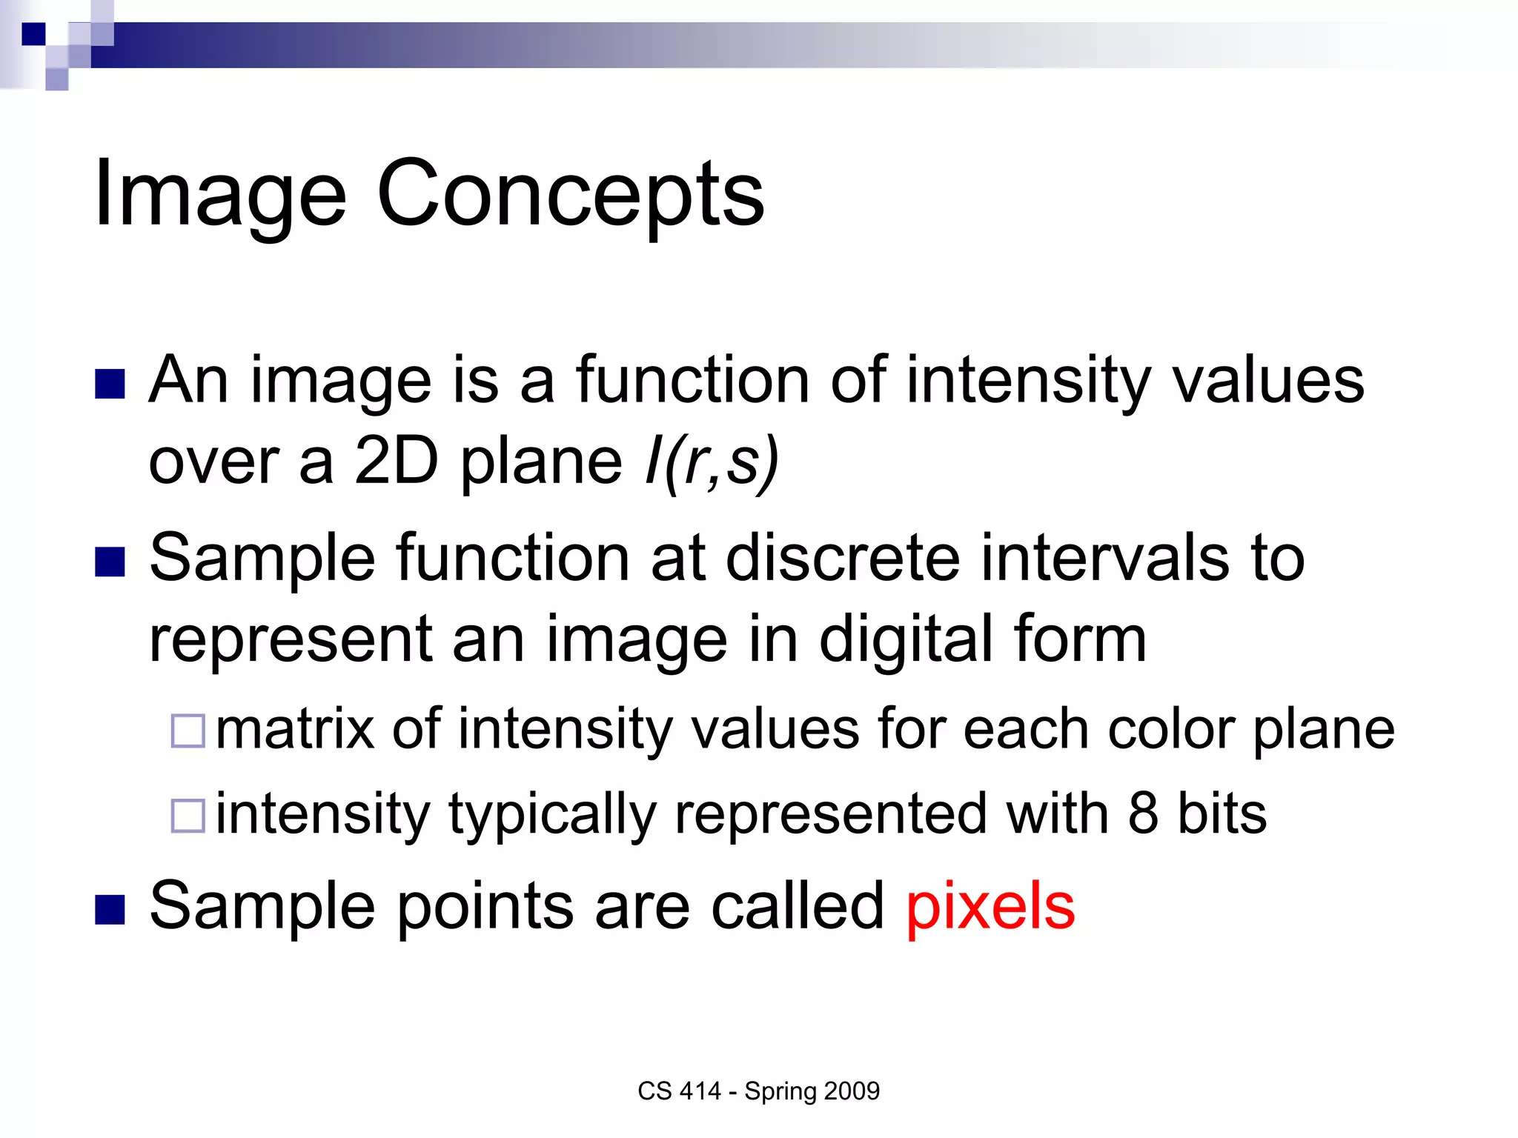

Slide 3
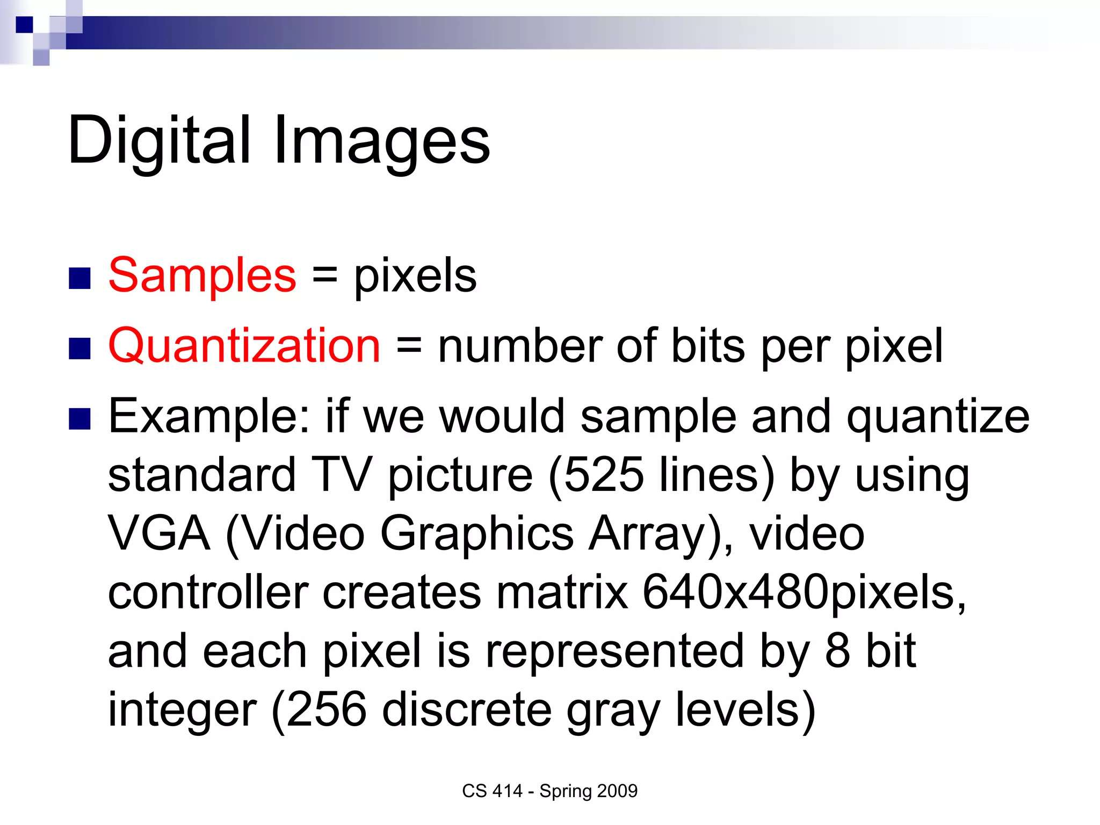

Slide 4
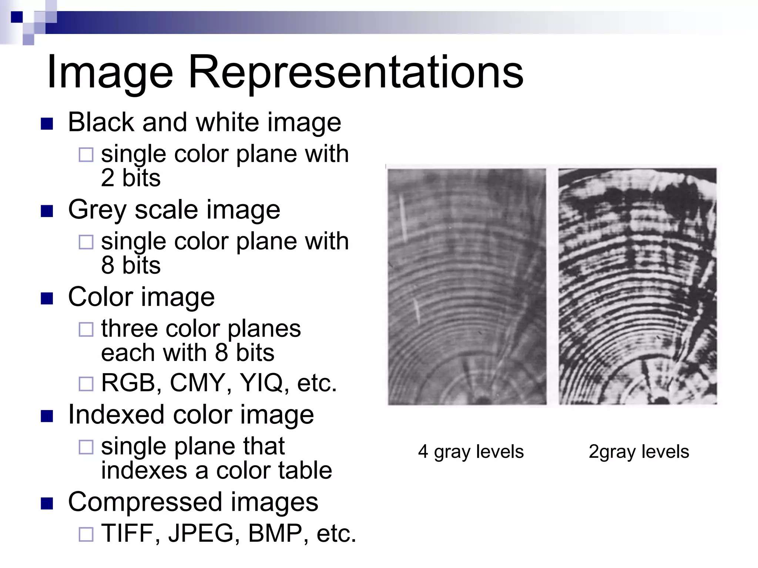

Slide 5
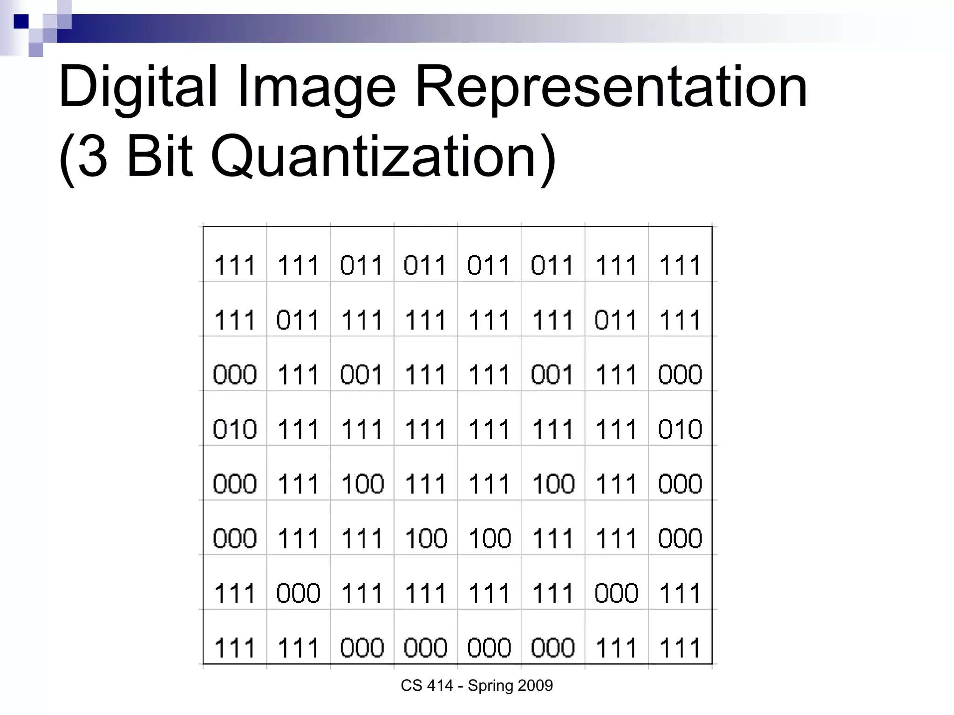

Slide 6
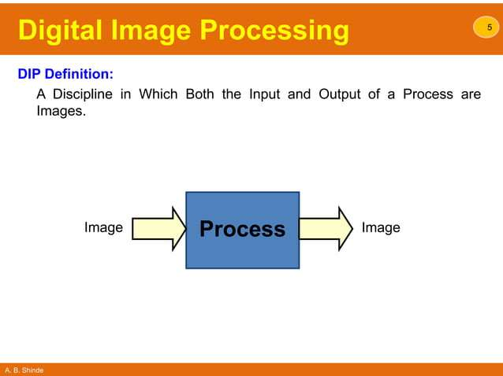

Slide 7
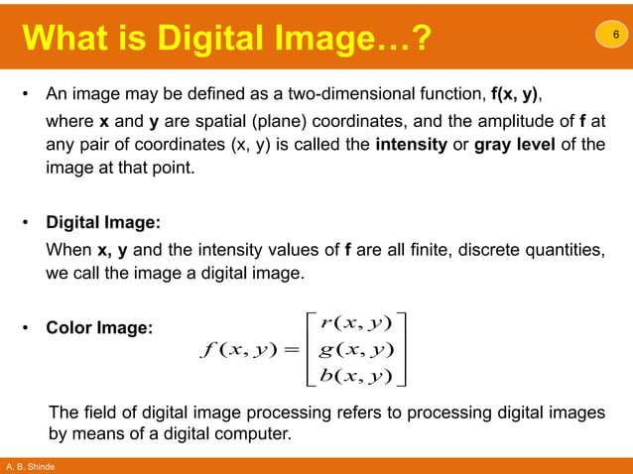

Slide 8
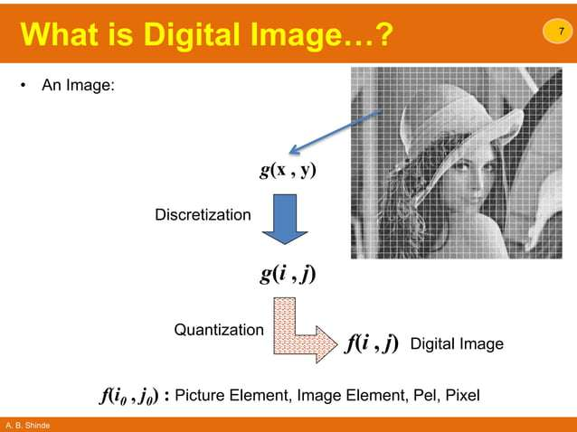

Slide 9
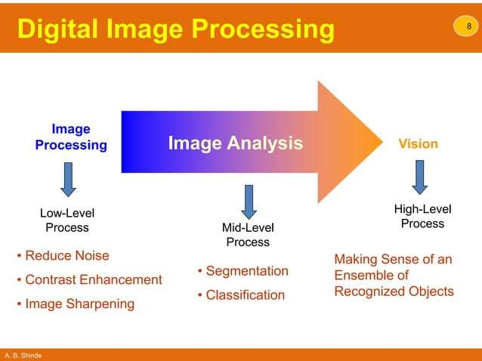

Slide 10
Pixel and Resolution
Pixel (Picture Element): A pixel is the smallest part of a computer picture. It shows one spot in the whole photo. Every little square has information about color, brightness and position. When these squares are put together with others they make a complete picture that we can see. Pixels are the parts that make up digital screens. They arrange together to show letters, pictures and videos.

Slide 11
Resolution
Image resolution refers to the number of pixel(picture element) that make up an Image. The resolution usually expressed as the number of pixel per unit of length.
Higher resolution result in more detailed and sharper image , while lower resolution may appear blurry or pixelated.
It's usually measured by width and height size. Using more details gives better results in pictures. Usual measurements for resolution are pixels per inch (PPI) for pictures that get printed and pixels per centimeter (PPCM

Slide 12
JPEG, GIF, and PNG
JPEG: Joint Photographic Experts Group
GIF: Graphics Interchange Format
PNG: Portable Network Graphics
BMP (Bitmap)
TIFF (or TIF, for the file extension; Tagged Image File Format)

Slide 13
JPEG and PNG
JPEG
A common format for web images and Microsoft Office documents. JPEGs use "lossy" compression, which means that the image quality decreases as the file size decreases.
PNG
A format for photos and pictures that need a transparent background or animations. PNGs use "lossless" compression, which means that the image quality is the same before and after compression.

Slide 14
GIF
A format that can reduce the size of images and short animations. GIF is the only format that supports animation, making it suitable for ads, banners, and memes.

Slide 15
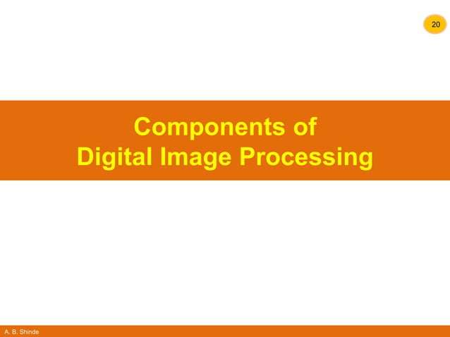

Slide 16
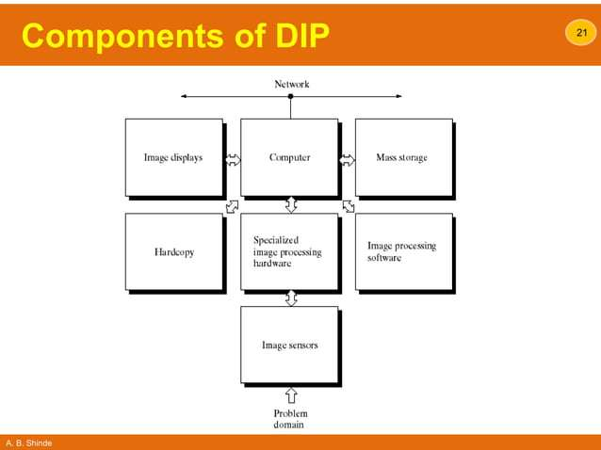

Slide 17
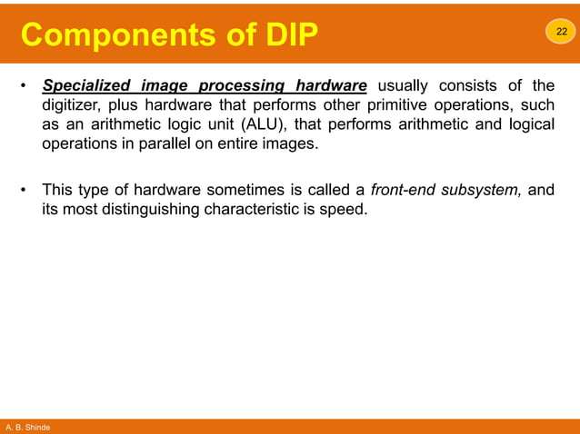

Slide 18
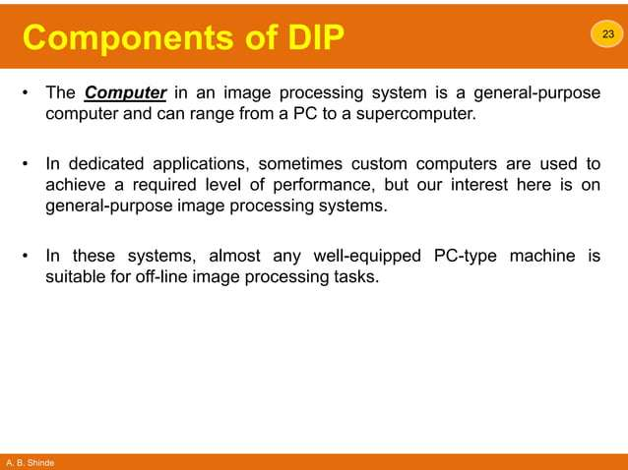

Slide 19
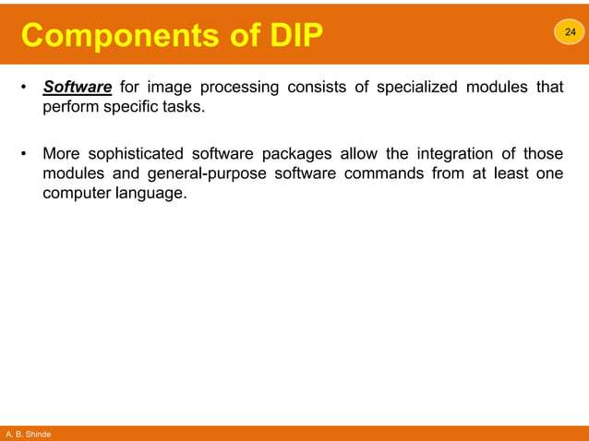

Slide 20
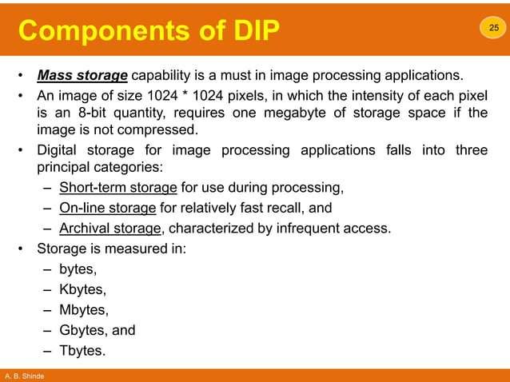

Slide 21
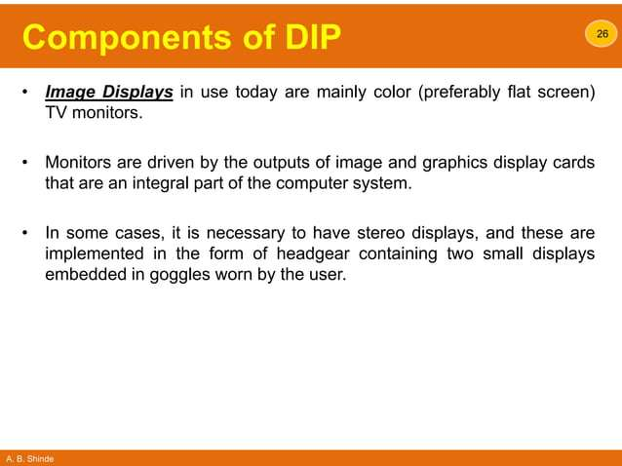

Slide 22
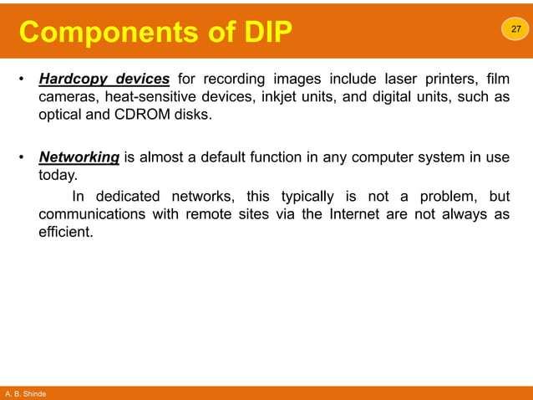

Slide 23
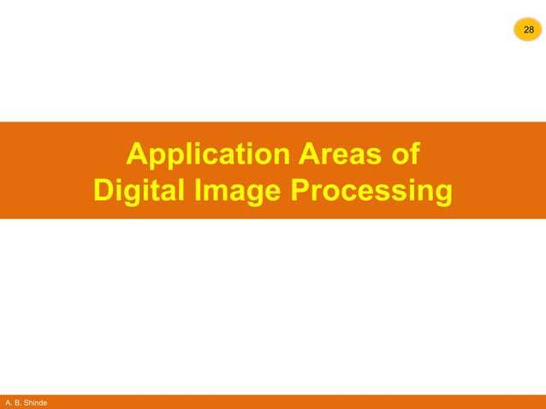

Slide 24
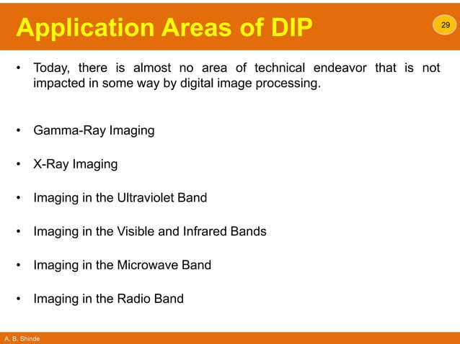

Slide 25
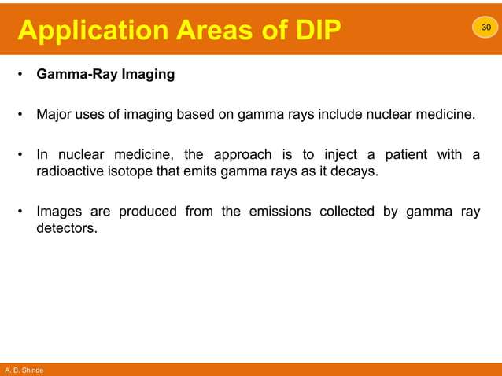

Slide 26
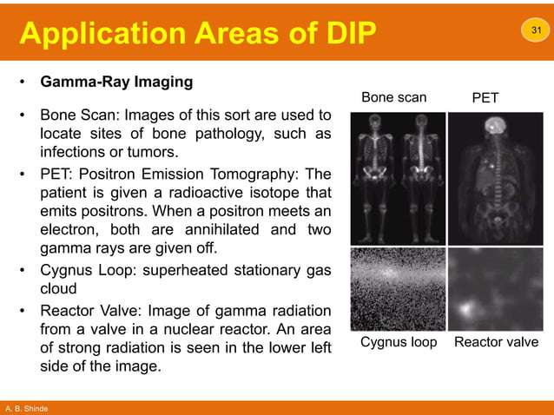

Slide 27
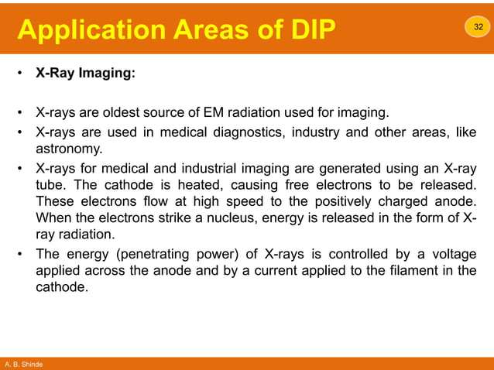

Slide 28
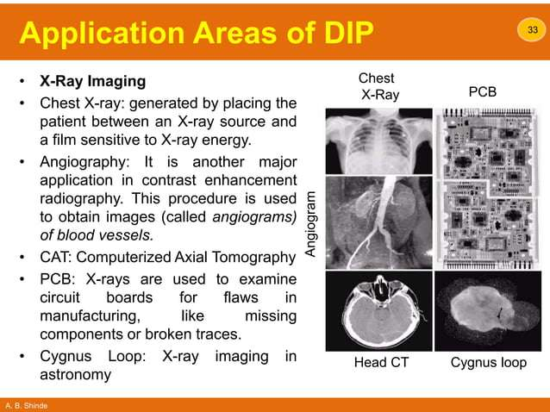

Slide 29
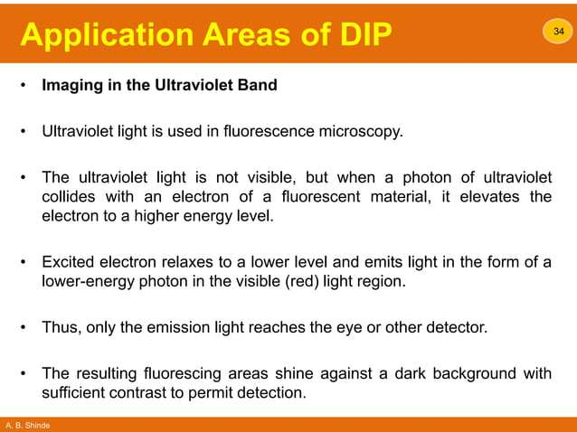

Slide 30
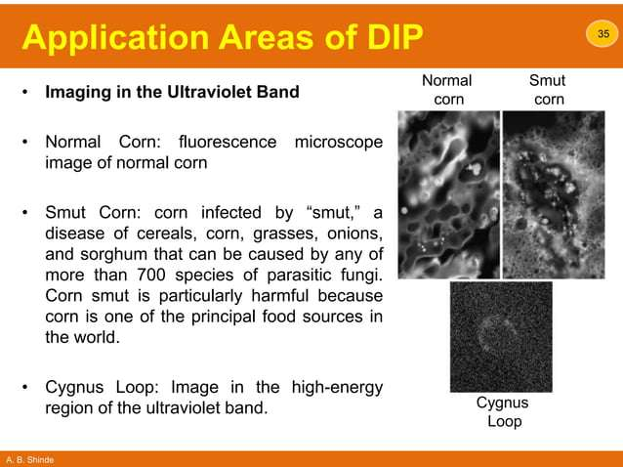

Slide 31
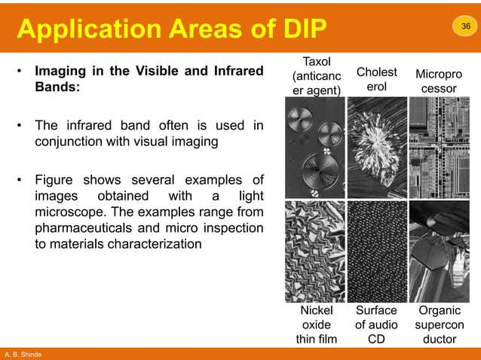

Slide 32
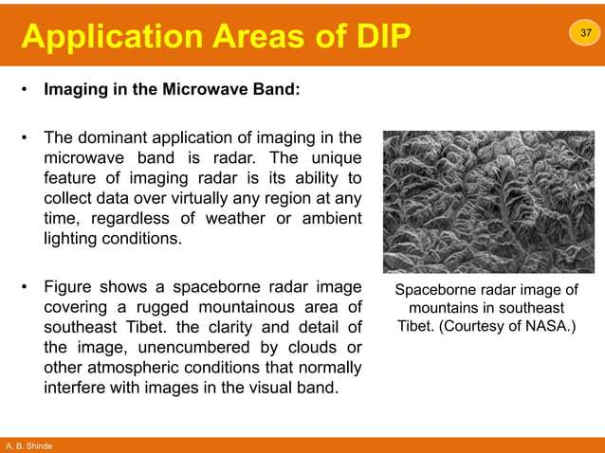

Slide 33
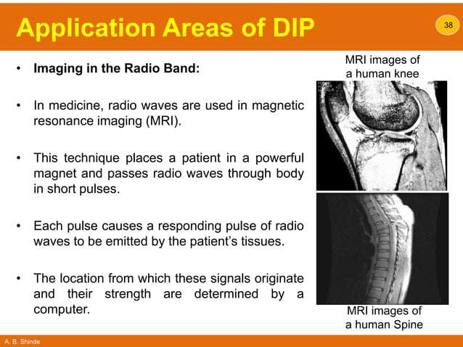

Slide 34
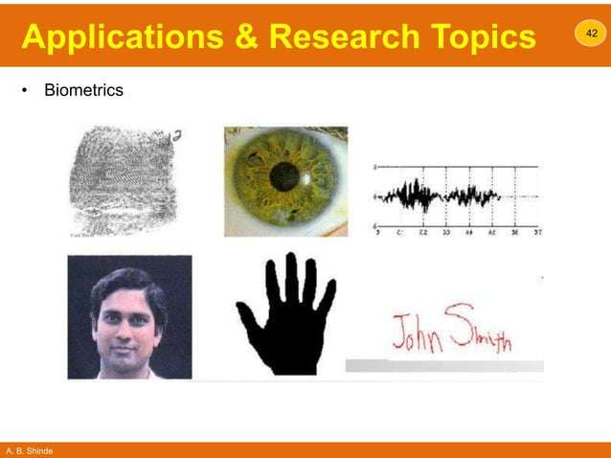

Slide 35
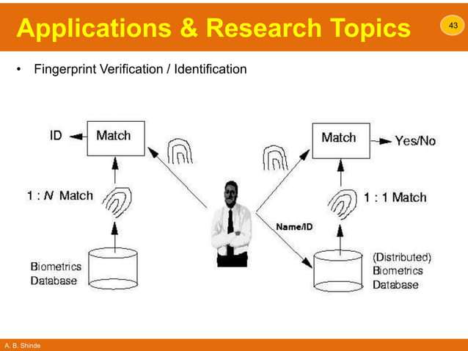

Slide 36
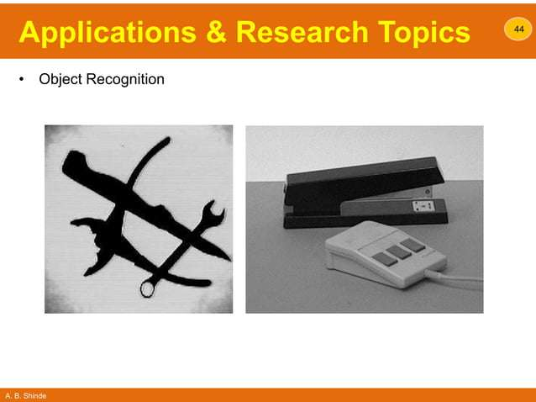

Slide 37
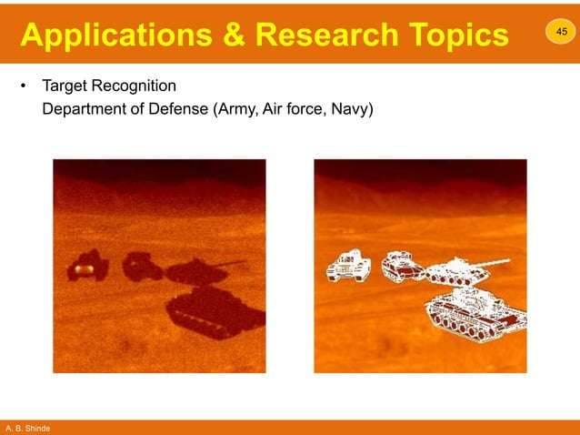

Slide 38
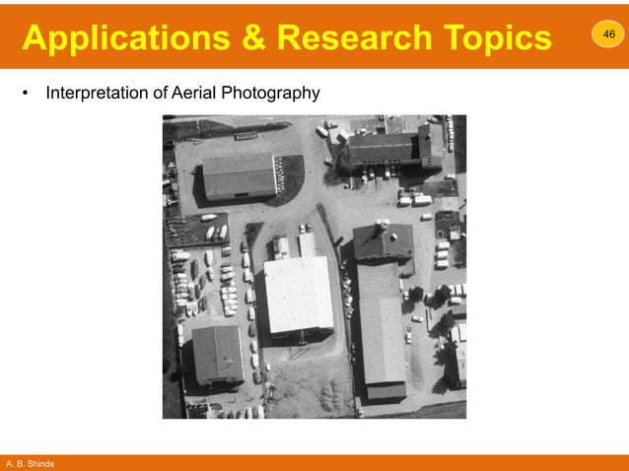

Slide 39
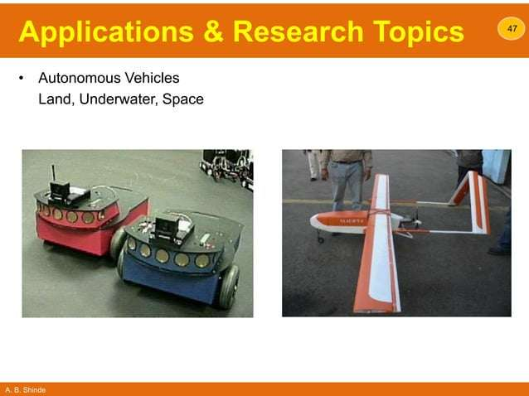

Slide 40
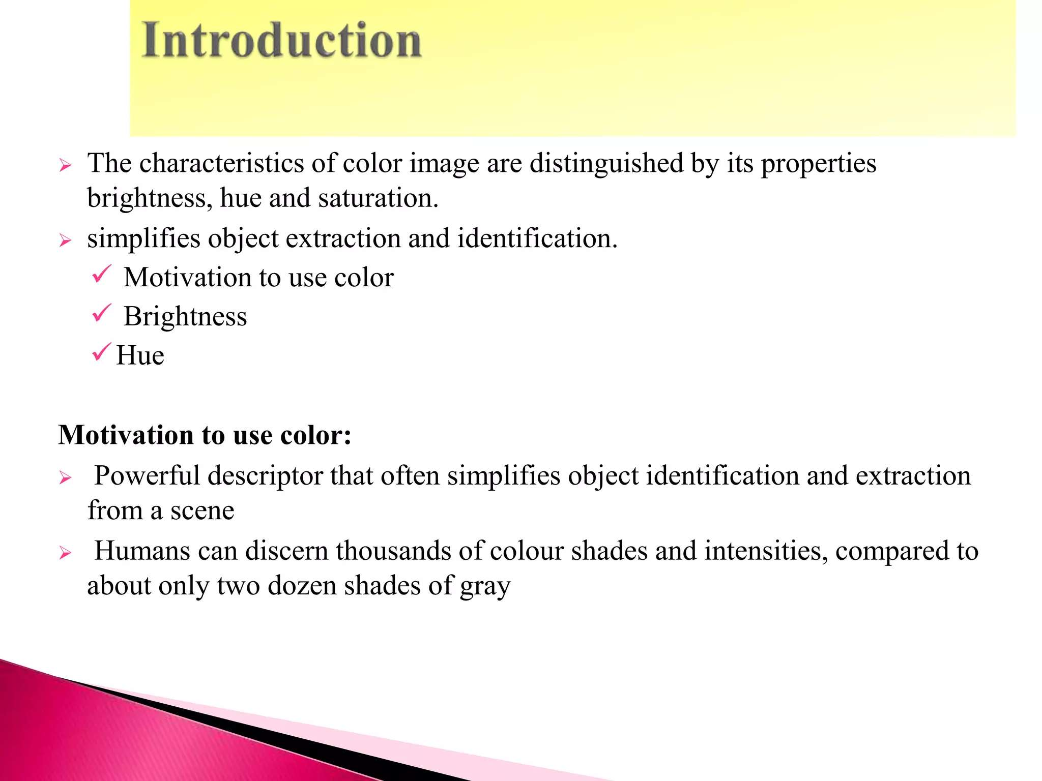

Slide 41
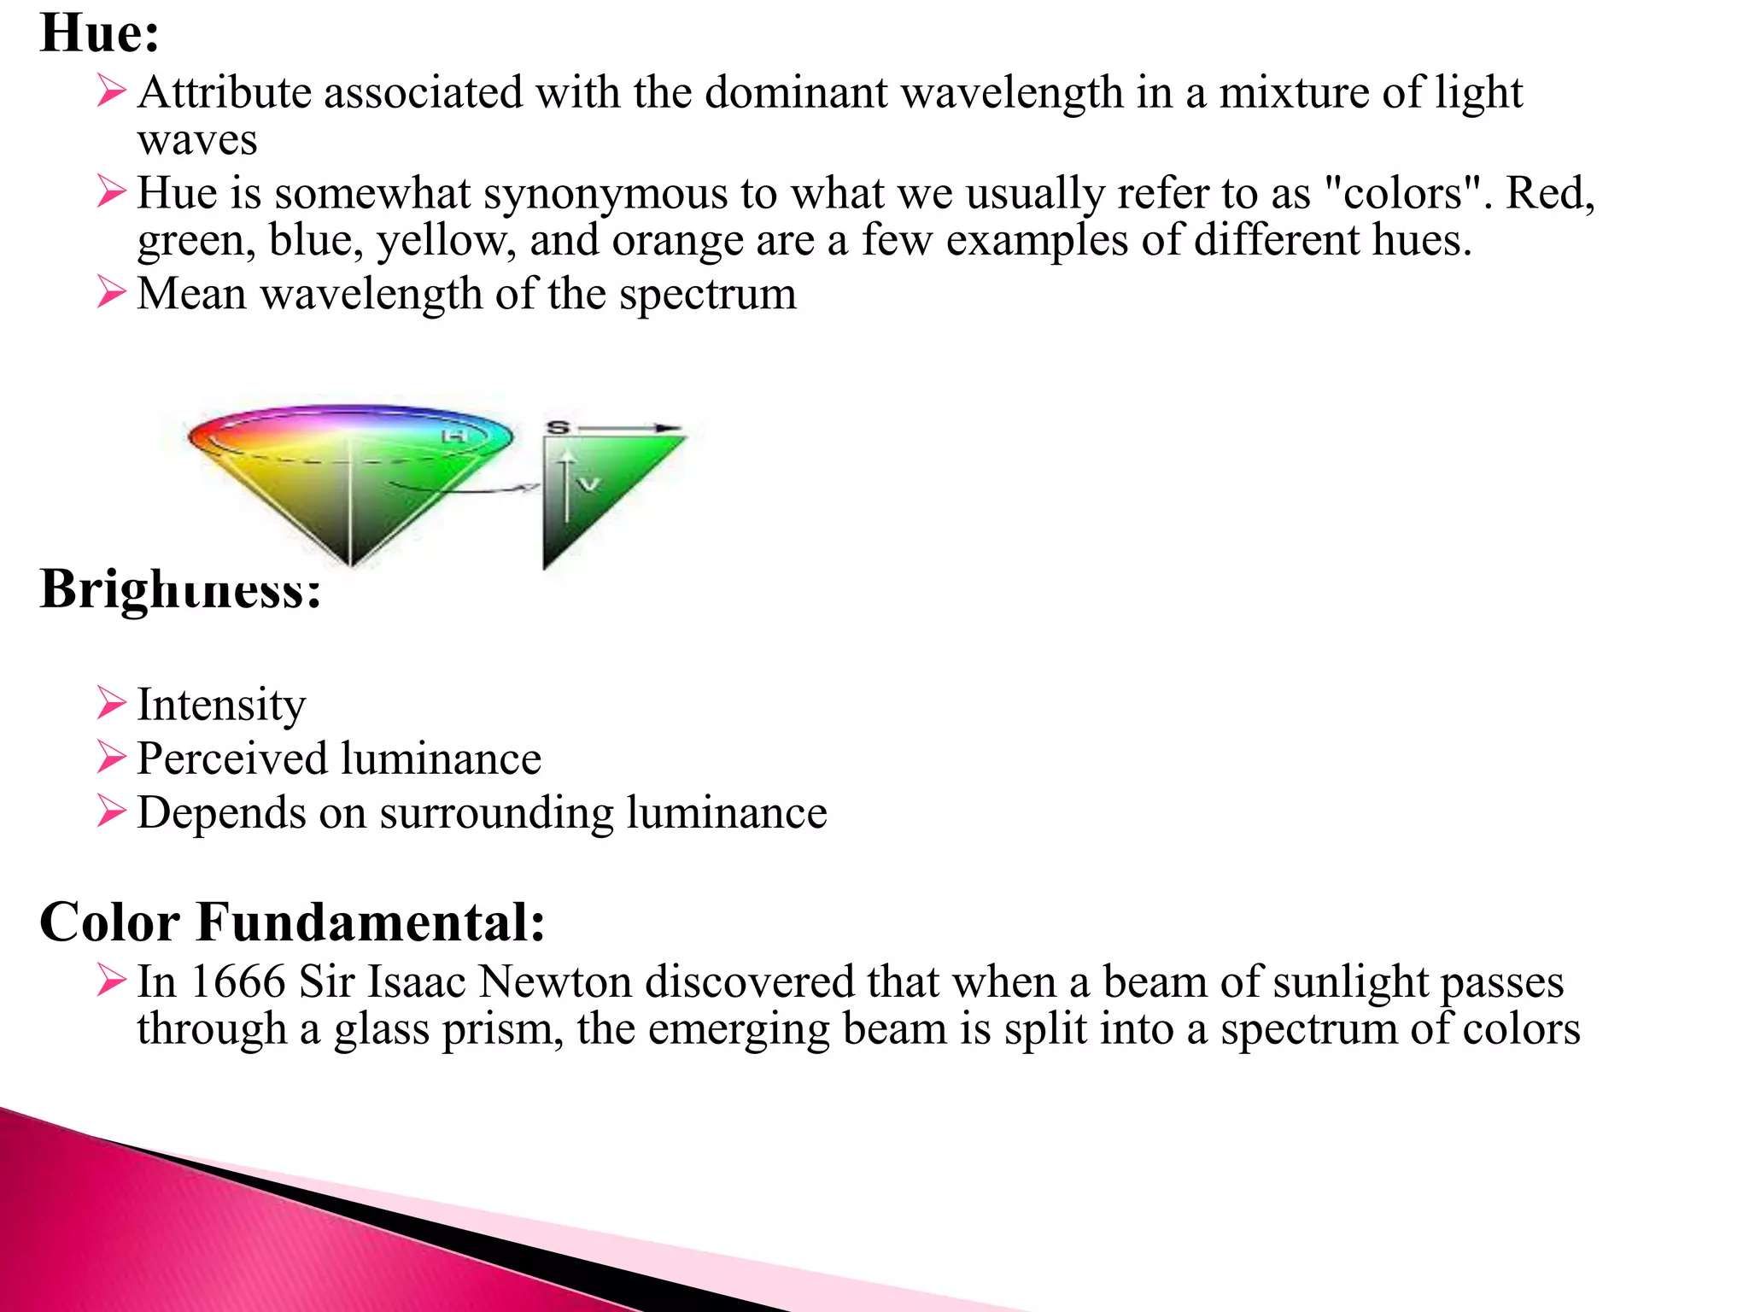

Slide 42
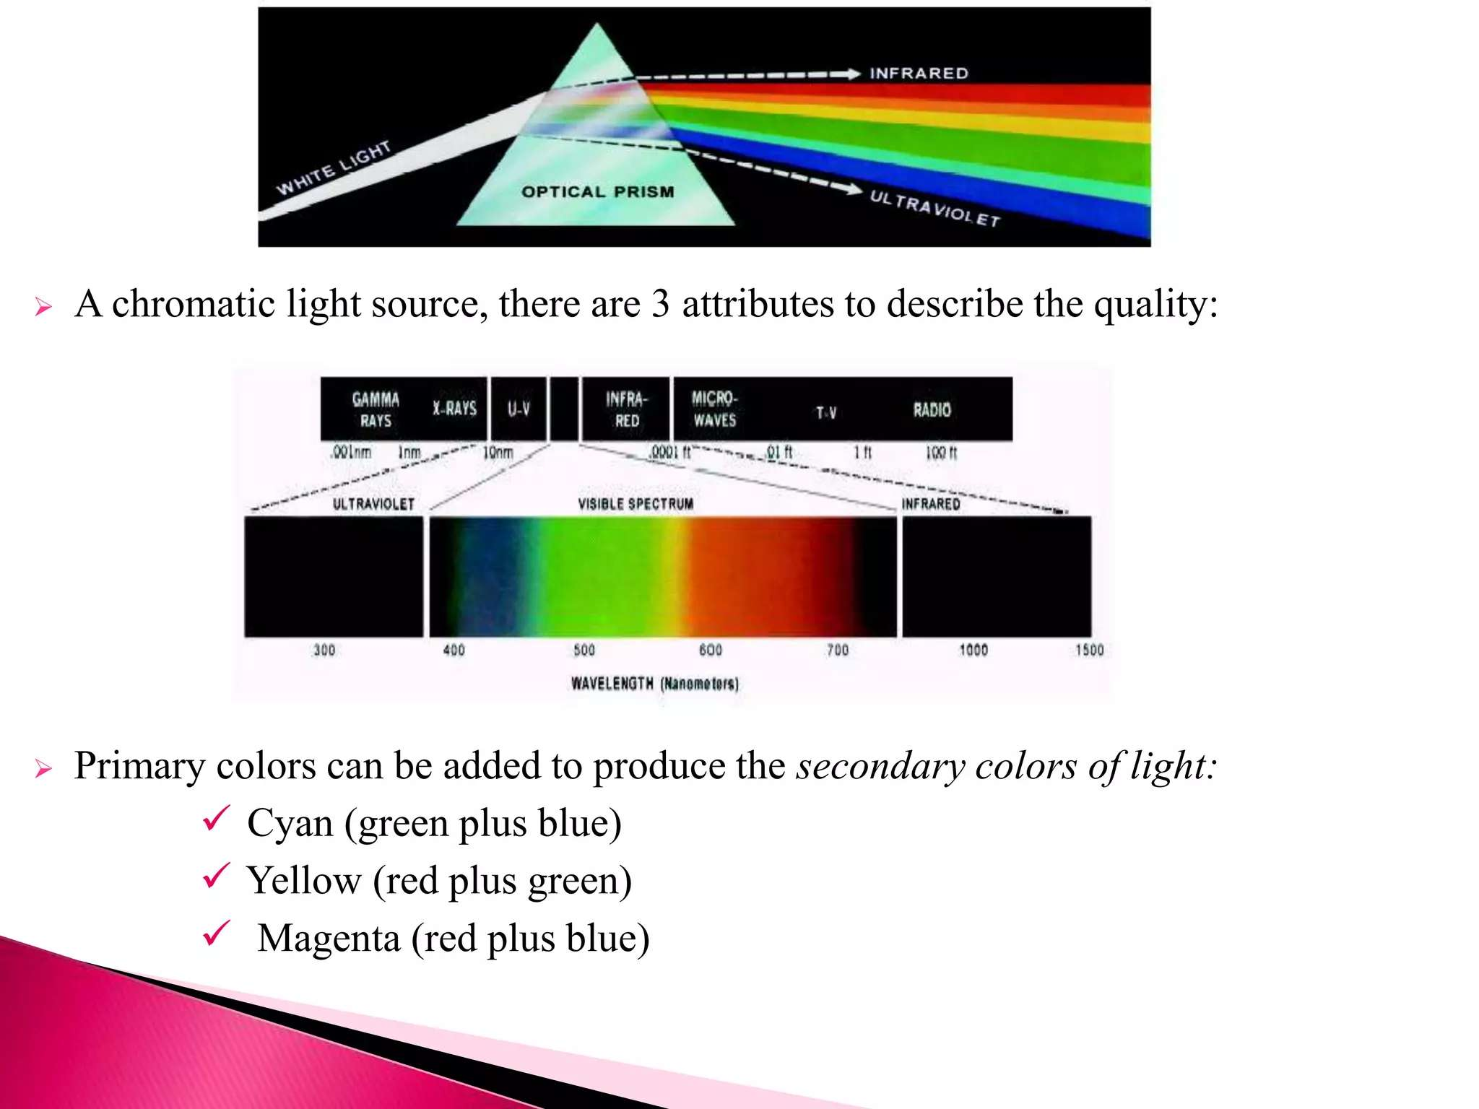

Slide 43
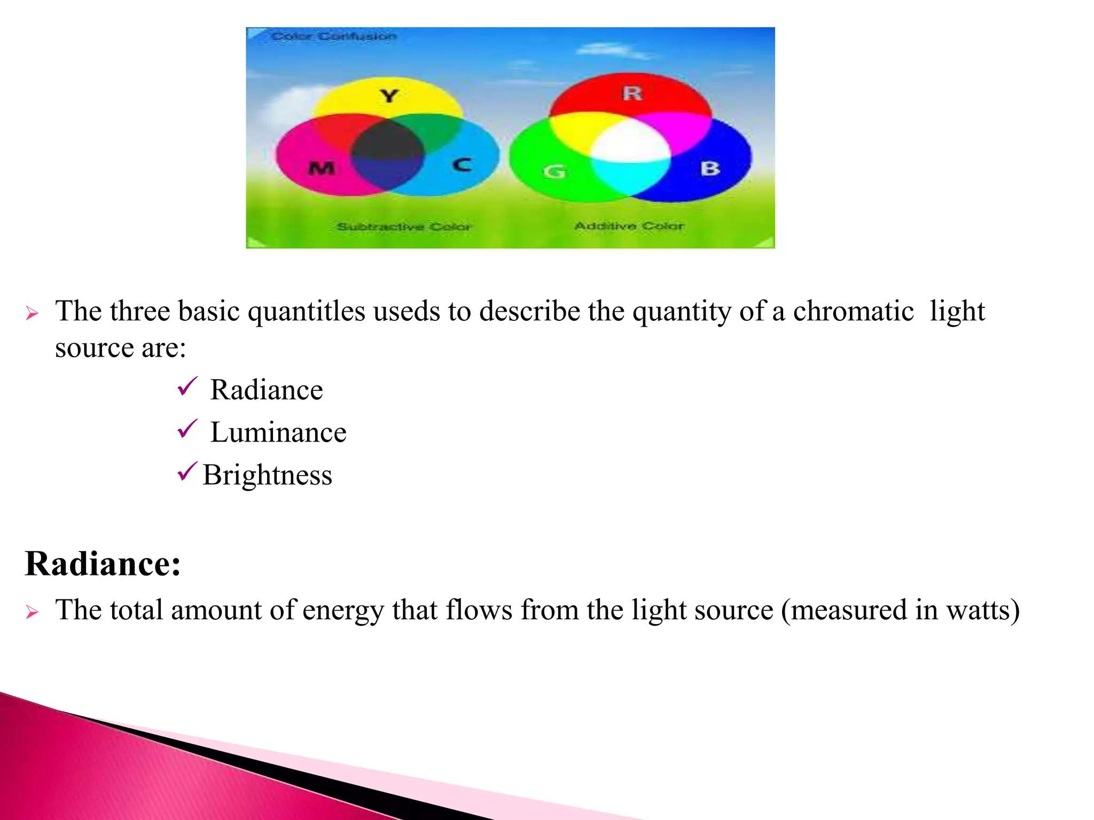

Slide 44
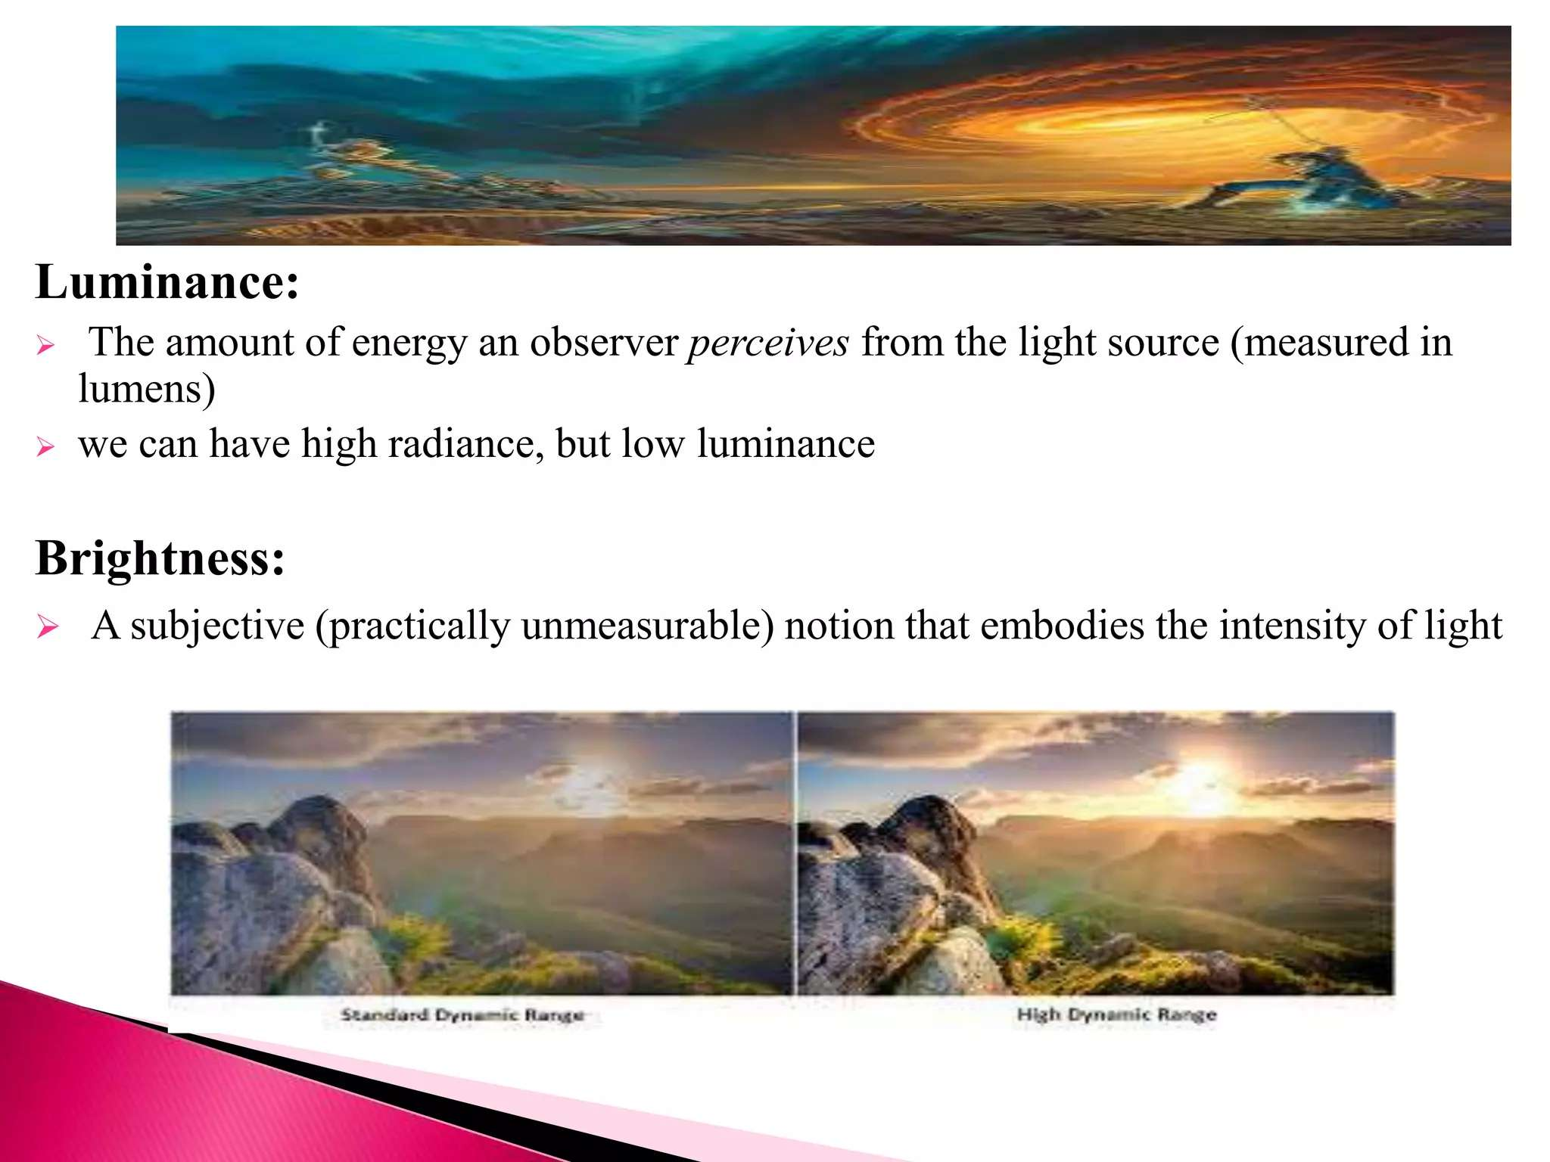

Slide 45
Changing brightness and contrast
Changing brightness and contrast: To adjust the brightness and contrast of an image in Python, we can use the OpenCV or Pillow
library.
For example, to increase the brightness of
an image using OpenCV, we can use the cv2.add() function, and to adjust the contrast, we can use the cv2.convertScaleAbs() function.

Slide 46
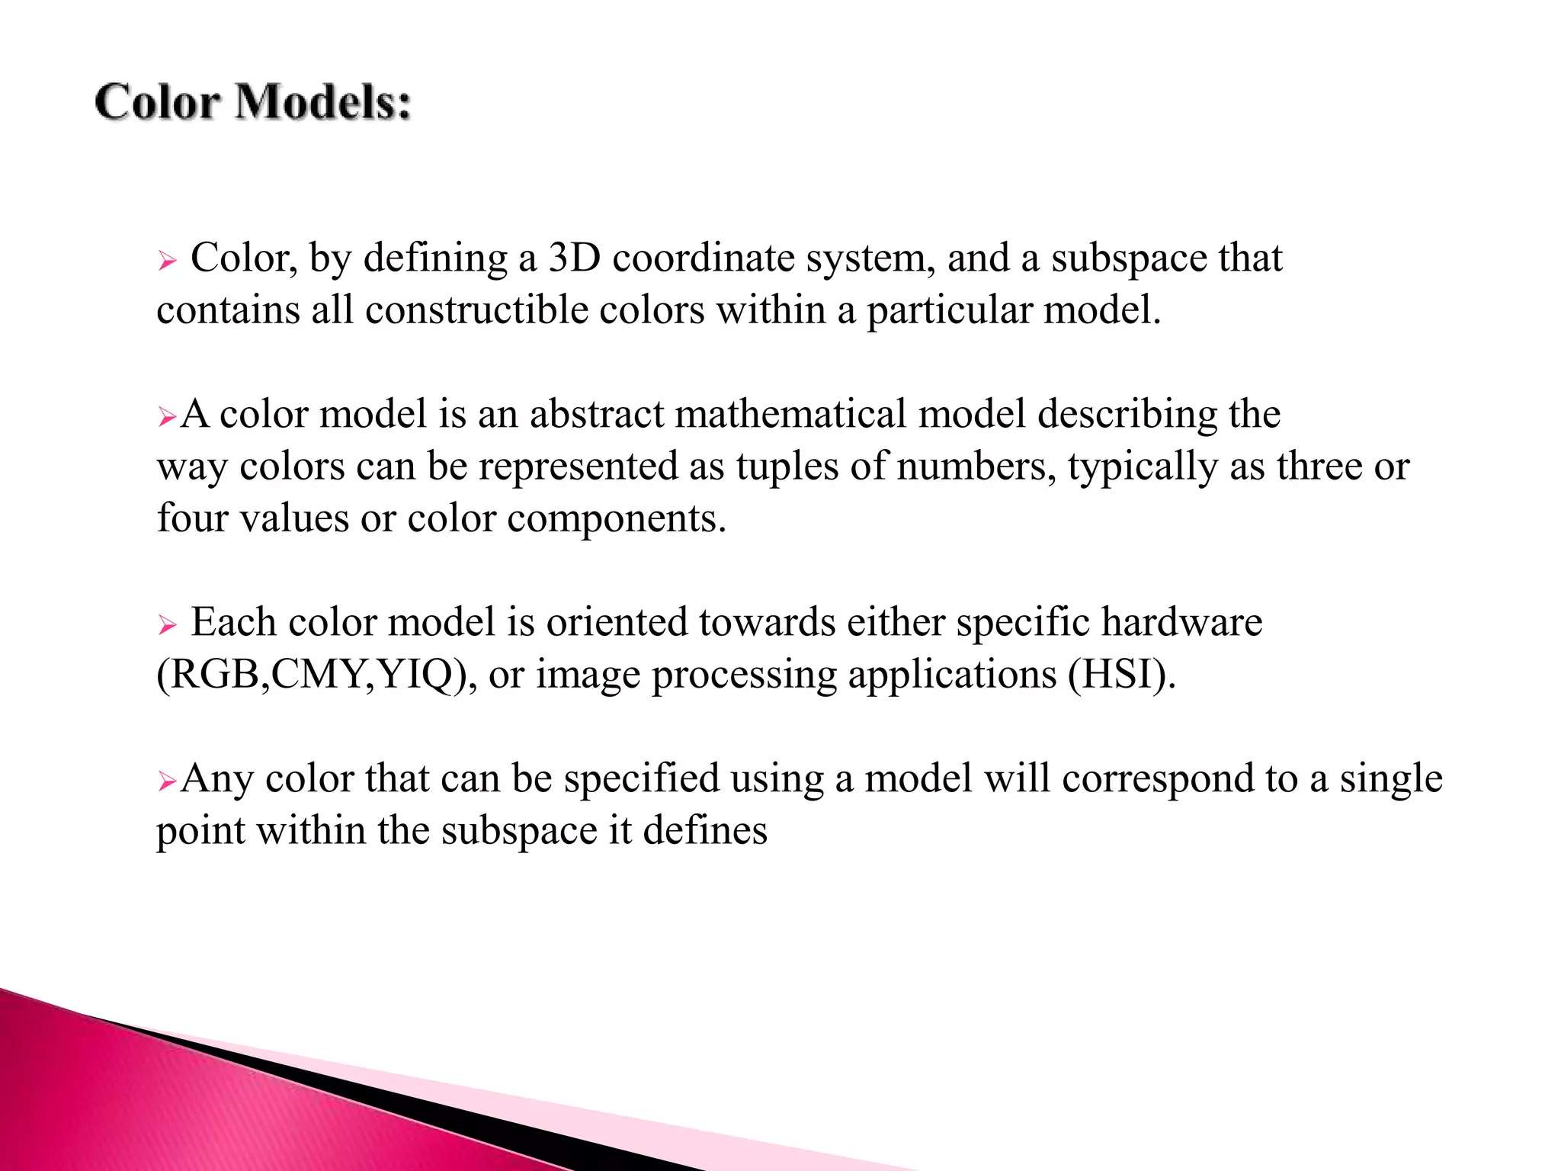

Slide 47
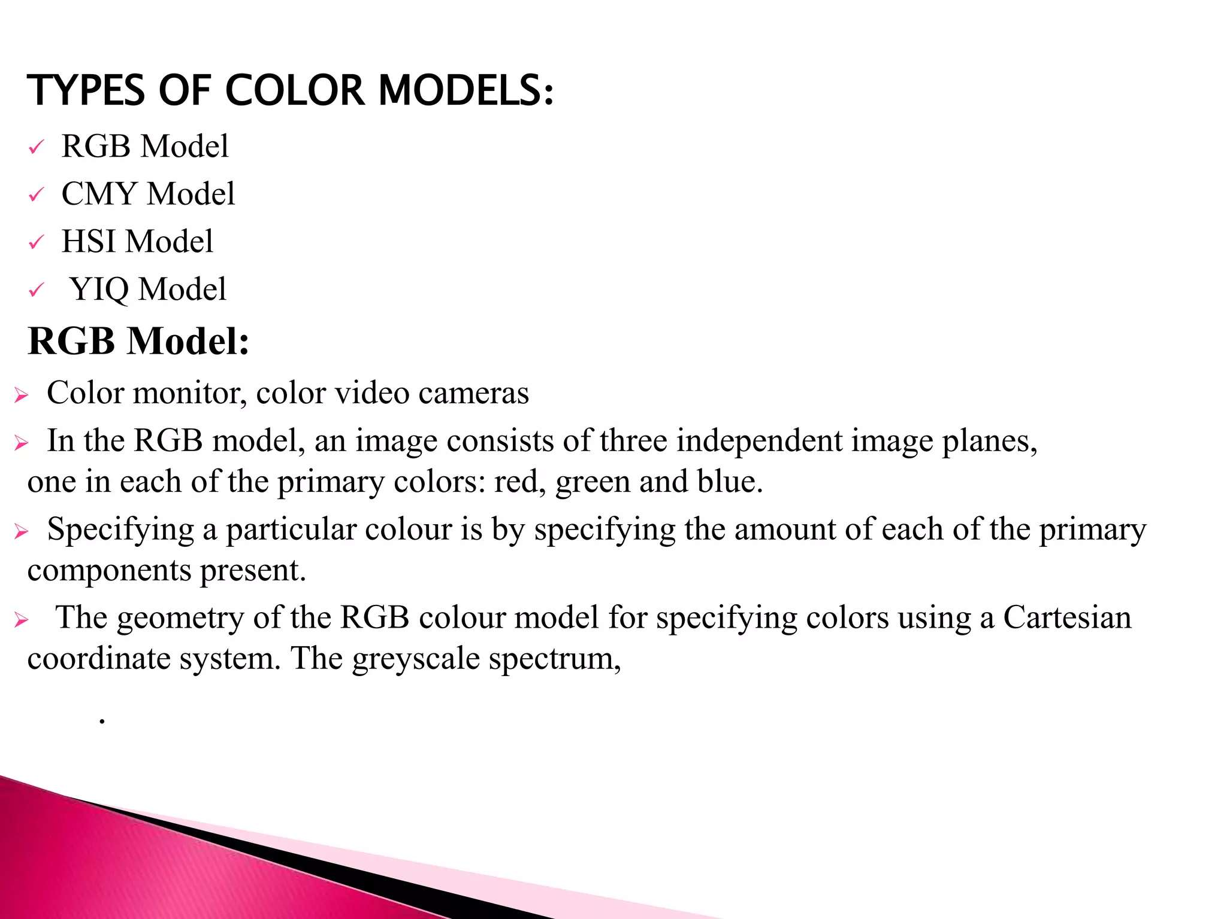

Slide 48
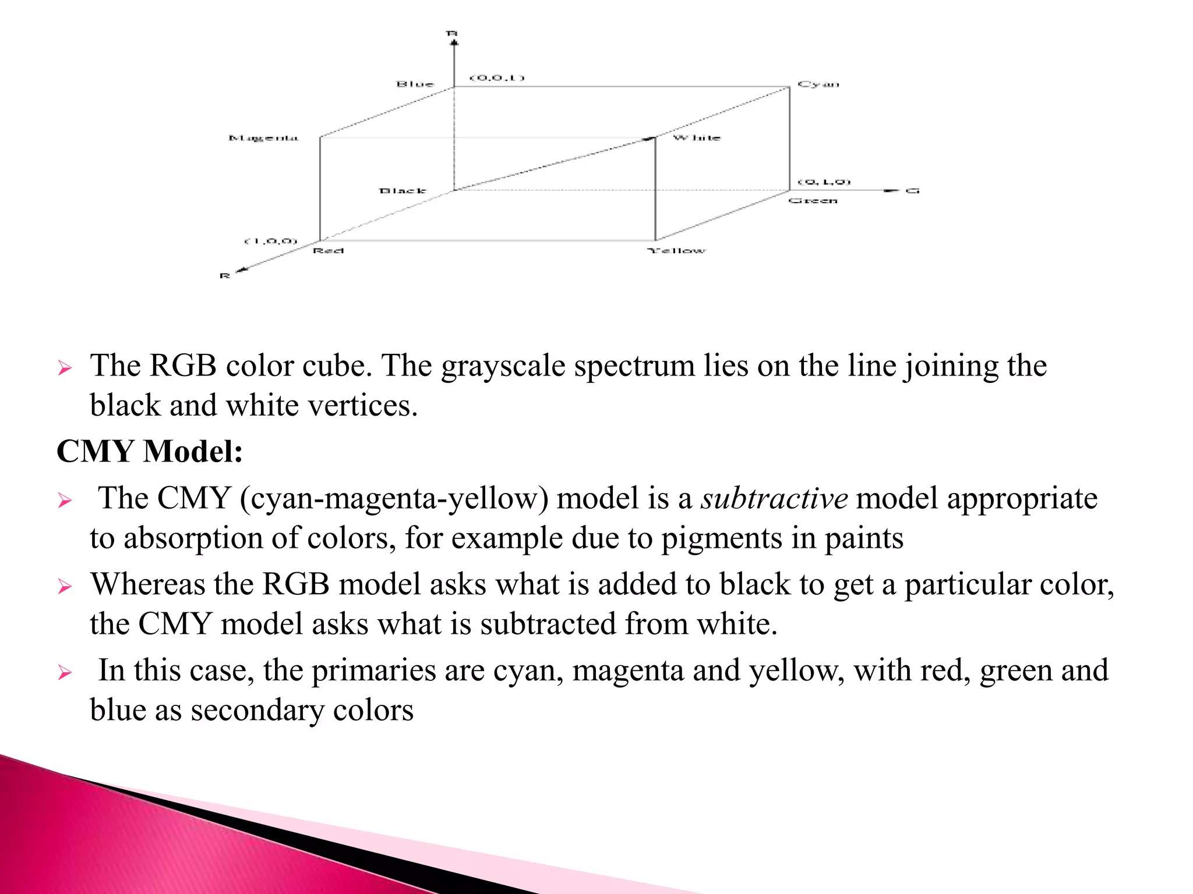

Slide 49
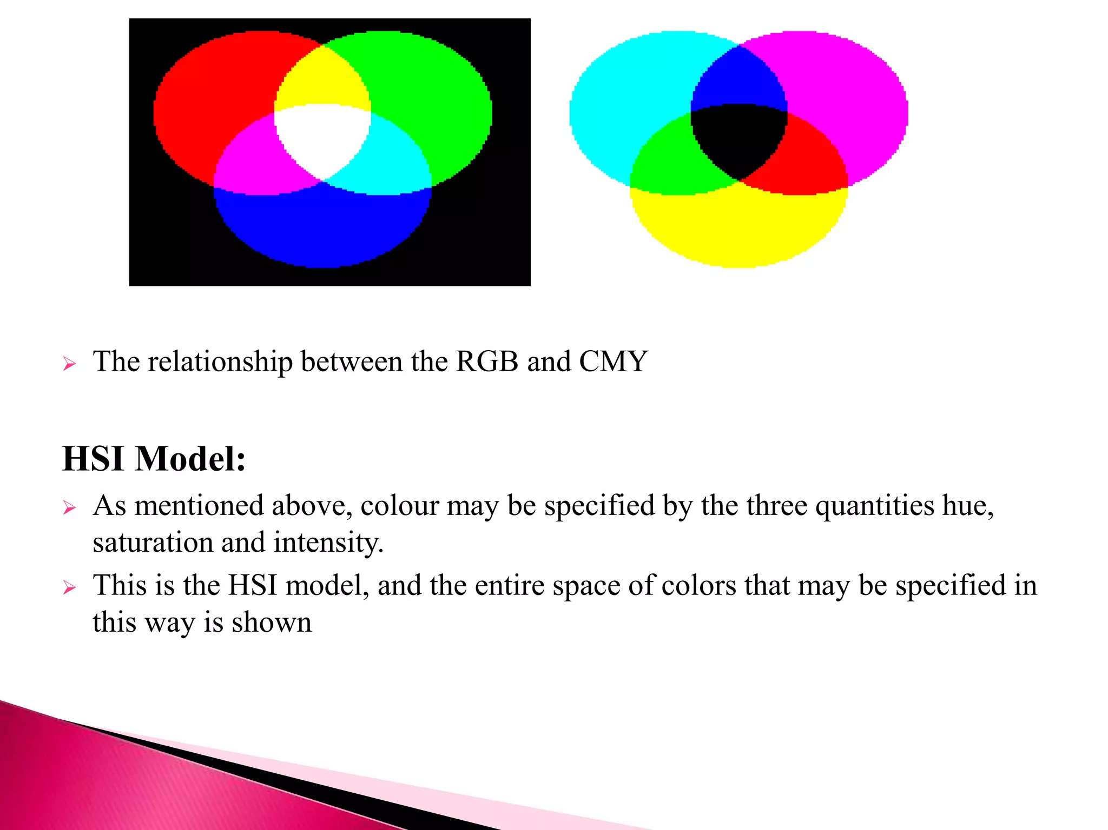

Slide 50
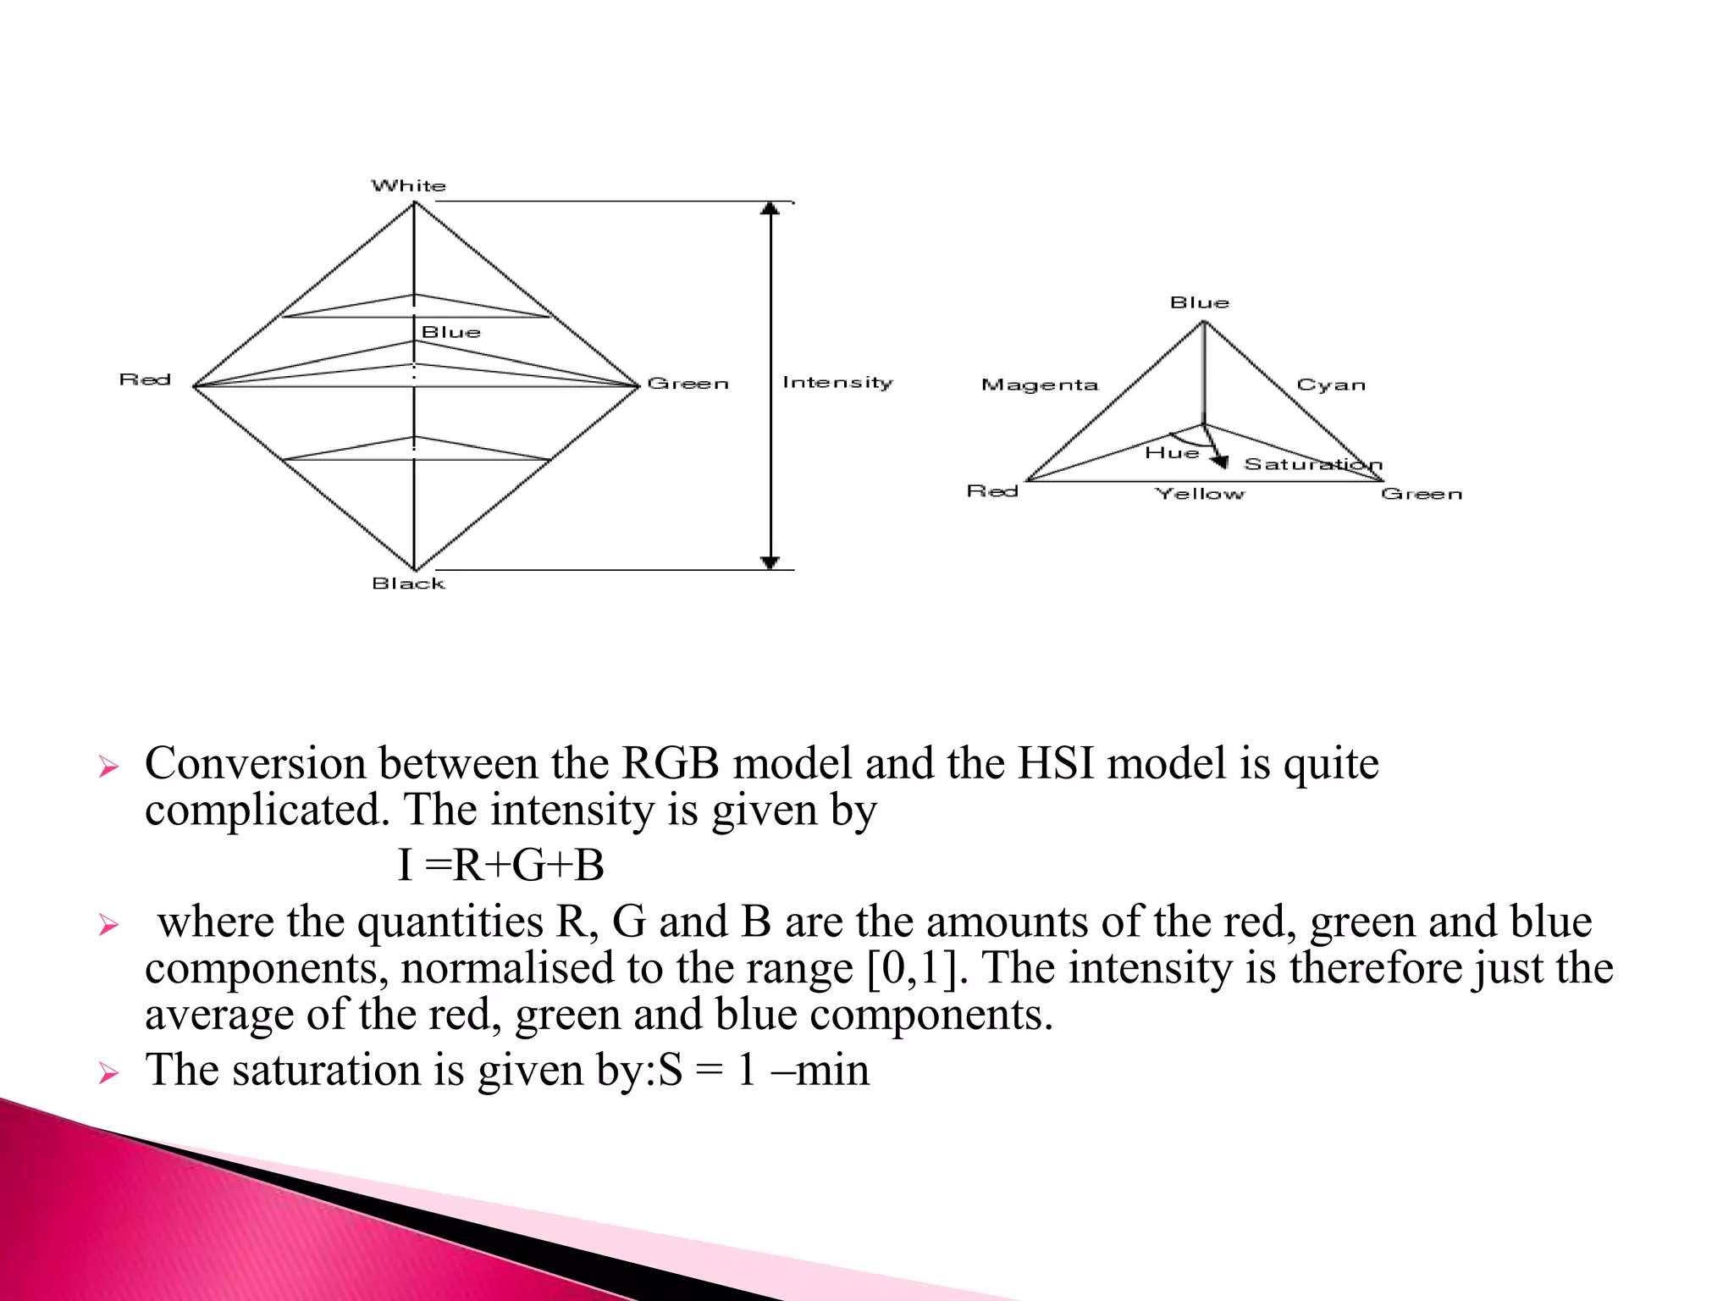

Slide 51
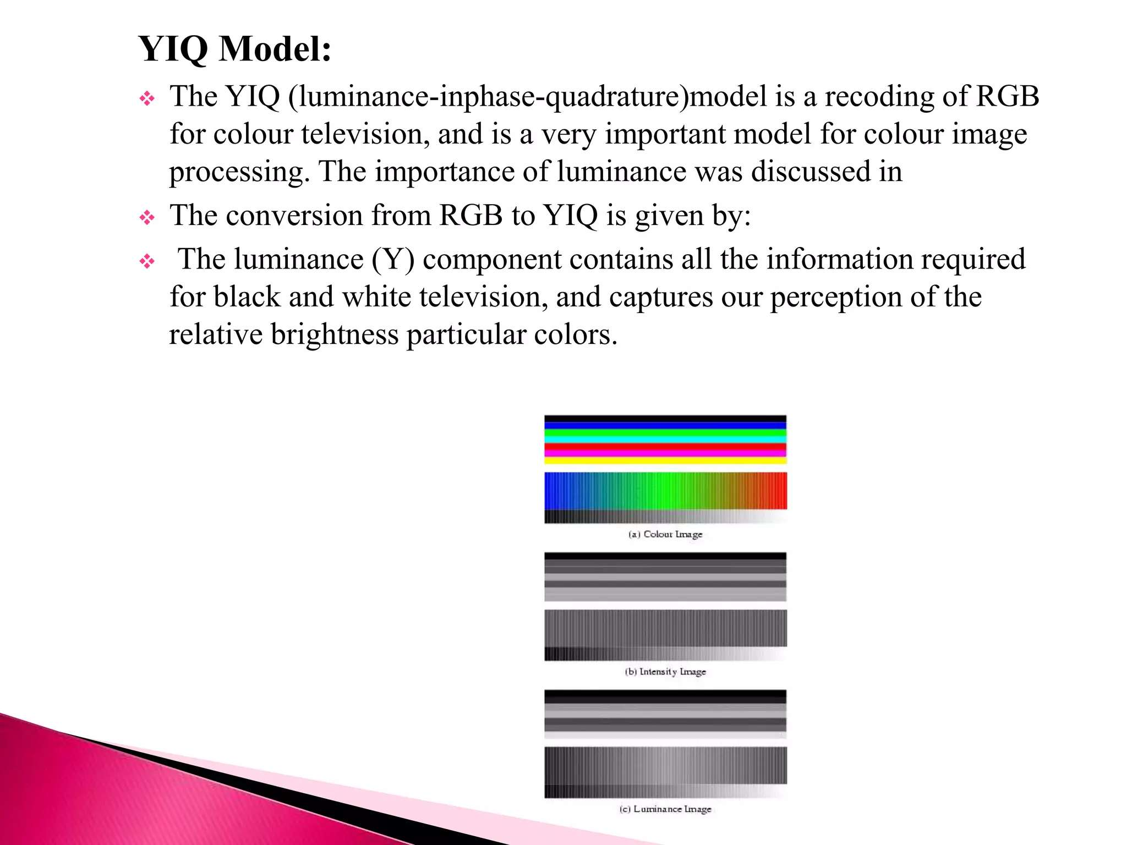

Slide 52
What is Hue?
The hue of a color is a component of its chromaticity. Red, green, and blue are the three main colors of light. It is why televisions, computers, and other electronic color visual displays use a ratio of red, green, and blue phosphors to generate all electrically conveyed colors.
Hue is a single value that describes the color of something and is typically measured in degrees.
It has the colors red, orange, yellow, green, blue, purple, and magenta all the way back to red.
Although, magenta and pink colors are not light frequencies, and a rainbow may prove it.
It begins with red and progresses to different colors, but it doesn't contain magenta and pink because they are not genuine frequencies humans can see.

Slide 53
What is Saturation?
Saturation: The intensity of a color. As saturation increases, colors appear sharper or purer. As saturation decreases, colors appear more washed-out or faded
Saturation is defined by the purity of the color and its distance from the grey color. If a color has much more greyness, it has a lower saturation level. Moreover, saturation could be viewed as the hue's dominance in the color.
The outermost edge of the hue wheel includes the pure hue; as you move inside the wheel to the centre, which contains grey, the hue steadily drops, and the saturation likewise falls.
It relates to a physical property known as the excitation property, which measures the percentage of brightness mixed with the dominant or pure color.

Slide 54
Saturation
Saturation: Saturation refers to the intensity of colors in an image, and it can be adjusted to make an image look more or less vivid. To adjust saturation in Python, you can use the cv2.cvtColor() function in OpenCV to convert an image from one color space to another, and
then adjust the saturation channel.
For example, to increase the saturation of an image using
the HLS color space, you can use the following code:

Slide 55
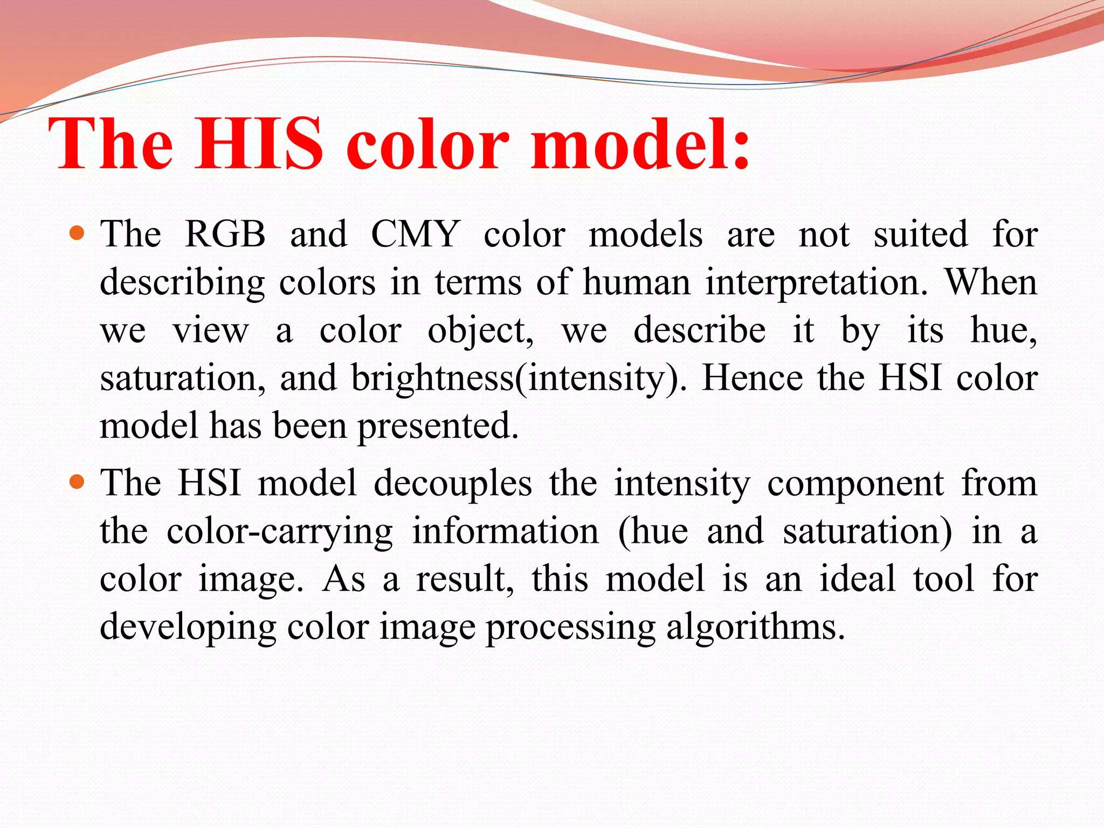

Slide 56
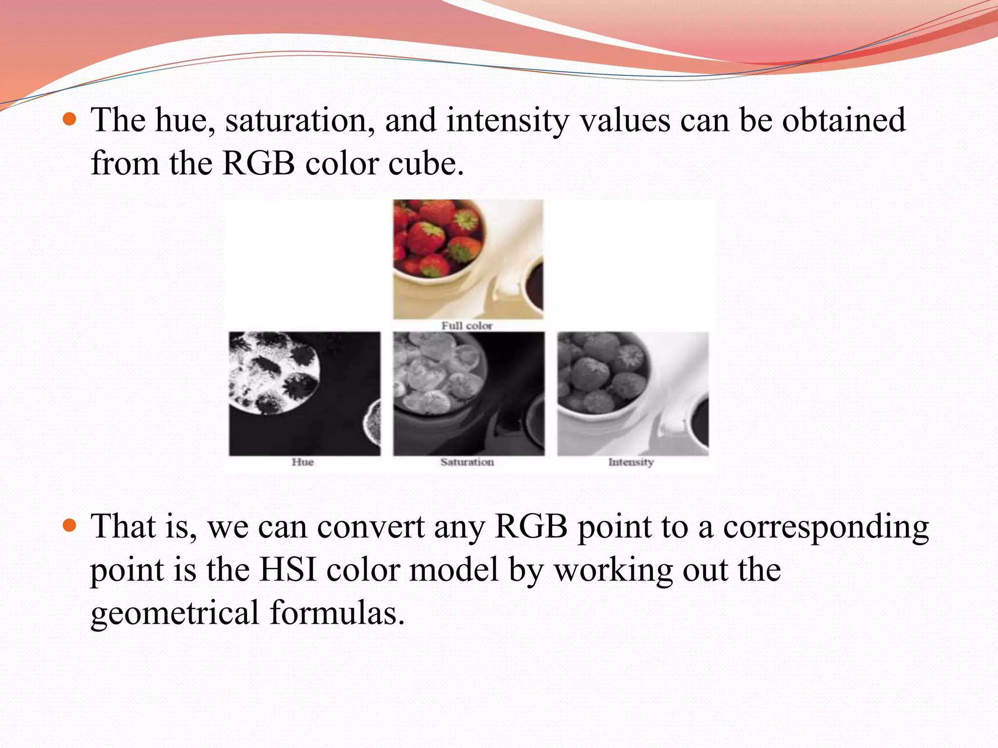

Slide 58
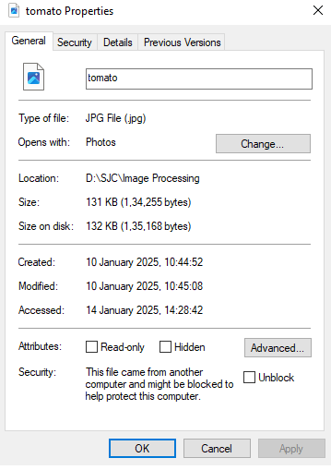
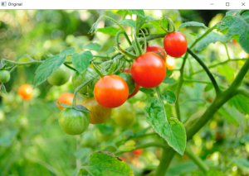

Slide 59
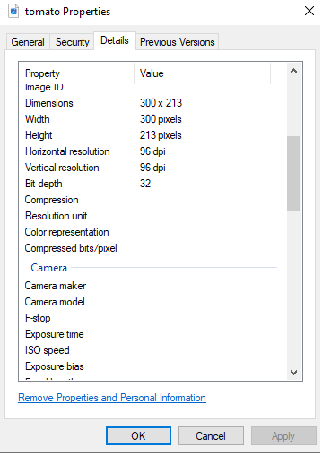

Slide 60


Slide 61


Slide 62


Slide 63


Slide 64


Slide 65


Slide 66


Slide 67
import cv2
import matplotlib.pyplot as plt
import numpy as np # Load the image image = cv2.imread('D://SJC//Image Processing//images//image2.jpg') plt.subplot(1, 2, 1)
plt.title("Original")
plt.imshow(image)
brightness = 10
contrast = 2.3
image2 = cv2.addWeighted(image, contrast, np.zeros(image.shape, image.dtype), 0, brightness
cv2.imwrite('modified_image.jpg', image2)
plt.subplot(1, 2, 2) plt.title("Brightness & contrast") plt.imshow(image2) plt.show()

Slide 68


Slide 69


Slide 70
import cv2
first_img = cv2.imread("D://SJC//Image Processing//images//iamge1.jpg")
second_img = cv2.imread("D://SJC//Image Processing//images//image2.jpg")
weightedSum=cv2.add(first_img , second_img)
cv2.imshow('Weighted Image', weightedSum) cv2.waitKey(0)cv2.destroyAllWindows()

Slide 71




Slide 72


Slide 73


Slide 74


